Slide 1
BUILDER DESIGN
PATTERN
Presented By:-
GOJIYA ANKITA
Enrollment No:-12008101
KUSHWAHA JYOTI
Enrollment No:-12008115

Slide 2
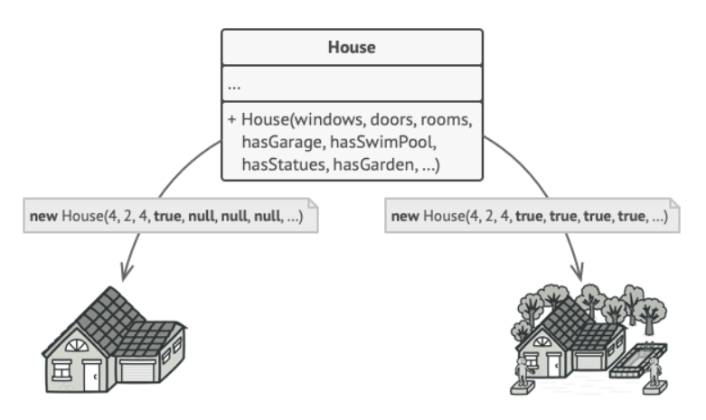
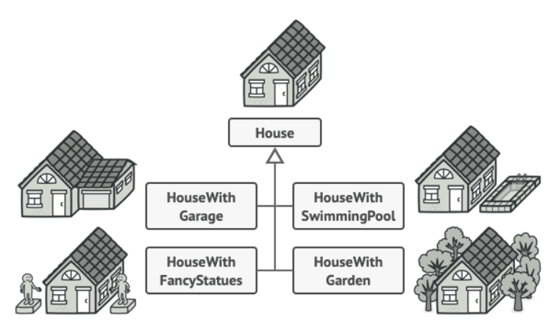
What is Builder Design Pattern?
Builder pattern was introduced to solve some of the problems when the Object contains a lot of attributes.

Slide 3
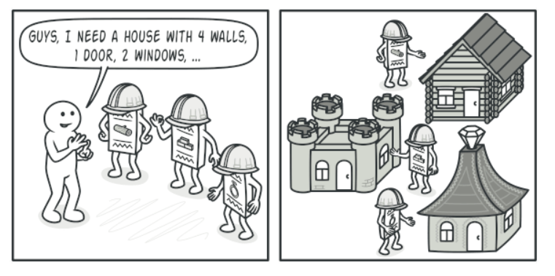
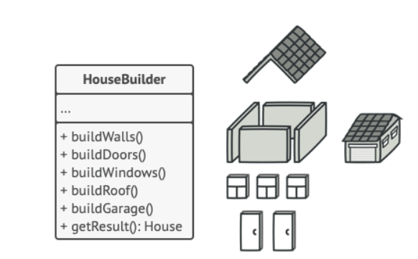

Slide 4
BUILDER DESIGN PATTERN
PROBLEM:-
let’s assume, our User object has following 5 attributes i.e. firstName, lastName, age, phone and address.
if you want to make a immutable User class, then you must pass all five information as parameters to constructor.
It will look like this:
public User (String firstName, String lastName, int age, String phone, String address)
{
this.firstName = firstName;
this.lastName = lastName;
this.age = age;
this.phone = phone;
this.address = address;
}

Slide 5
BUILDER DESIGN PATTERN
Now what if only firstName and lastName are mandatory and rest 3 fields are optional. Problem !! We need more constructors.
public User (String firstName, String lastName, int age, String phone){ ... }
public User (String firstName, String lastName, String phone, String address){ ... }
public User (String firstName, String lastName, int age){ ... }
public User (String firstName, String lastName){ ... }
We will need some more like above. Still can manage? Now let’s introduce our sixth attribute i.e. salary. Now it is problem.
Here, builder pattern will help you to consume additional attributes while retaining the immutability of Use class.

Slide 6
BUILDER DESIGN PATTERN
INTENT:-
Separate the construction of a complex object from its representation so that the same construction process can create different representation.
APPLICABILITY:-
Use the Builder pattern when:
The construction process must allow different representations for the object that is constructed.

Slide 7
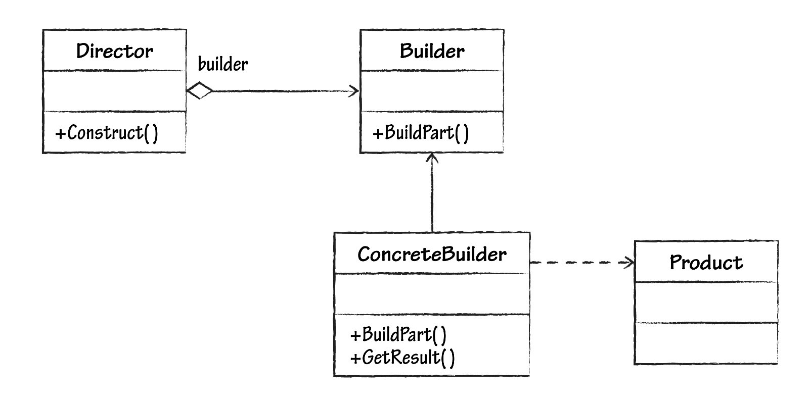

BUILDER DESIGN PATTERN
STRUCTURE:-

Slide 8
BUILDER DESIGN PATTERN
PARTICIPANTS:-
Builder
specifies an abstract interface for creating parts of a Product object.
ConcreteBuilder
constructs and assembles parts of the product by implementing the Builder interface.
defines and keeps track of the representation it creates.
Director
constructs an object using the Builder interface.
Product
The product class defines the complex object that is to be generated by the builder pattern.

Slide 9
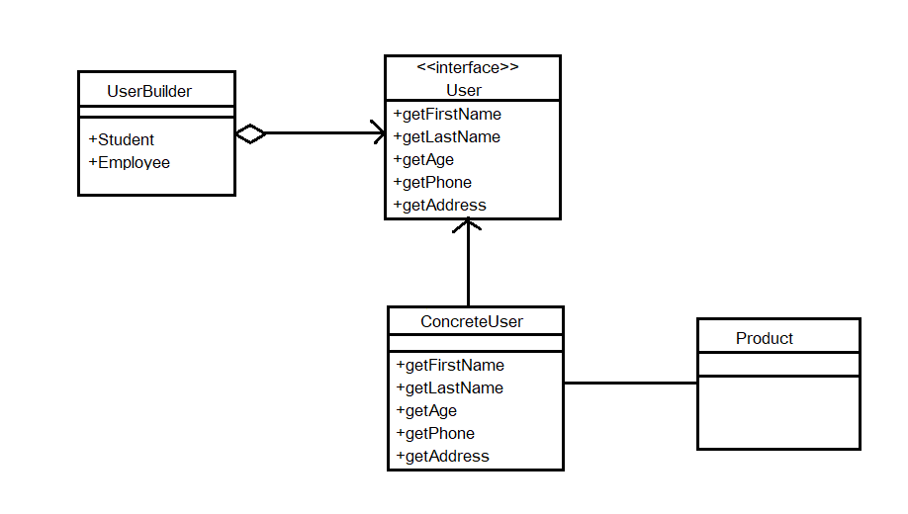
CLASS DIAGRAM:-

Slide 10
BUILDER DESIGN PATTERN
COLLABORATION:-
The client creates the Director object and configures it with the desired Builder object.
Director notifies the Builder whenever a part of the product should be built.
Builder handles the requests from the Director and adds parts to the product.
The client retrieves the product from the Builder.

Slide 11
ADVANTAGES:-
Builder pattern also helps minimizing the number of parameters in constructor and thus there is no need to pass in null for optional parameters to the constructor.
It provides clear separation between the construction and representation of an object.
It supports to change the internal representation of objects.

Slide 12
BUILDER DESIGN PATTERN
DISADVANTAGES:-
Requires creating a separate ConcreteBuilder for each different type of product.
Requires the builder classes to be mutable.

Slide 13
BUILDER DESIGN PATTERN
QUESTIONS
1.How many participants in the builder design pattern?
-> 4
2.Builder Design Pattern comes in which design pattern?
->Creational Design Pattern
3.What is the work of Director?
->constructs an object using the Builder interface
4. Advantage of Builder Design Pattern?
->It provides clear separation between the construction and representation of an object
5.Builder Design Pattern supports to change the internal representation of _________.
->Object

Slide 14
THANK YOU

